Slide 1
The Denoising Problem in the mirror of CS and Statistics
Dan Vilenchik
Ben-Gurion University

Slide 2
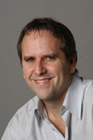
The water and oil problem
Michael Jordan, Prof. of Statistics at UC Berkeley
Presented at the National Science Foundation (NSF) in late January for the NSF Data Science Seminar Series
The core theories in computer science and statistics developed separately and there is an oil and water problem
Core statistical theory doesn’t have a place for runtime and other computational resources
Core computational theory doesn’t have a place for statistical risk
http://magazine.amstat.org/blog/2016/03/01/jordan16/

Slide 3
The plan for this talk
Physics
Statistics
Computer Science

Slide 4
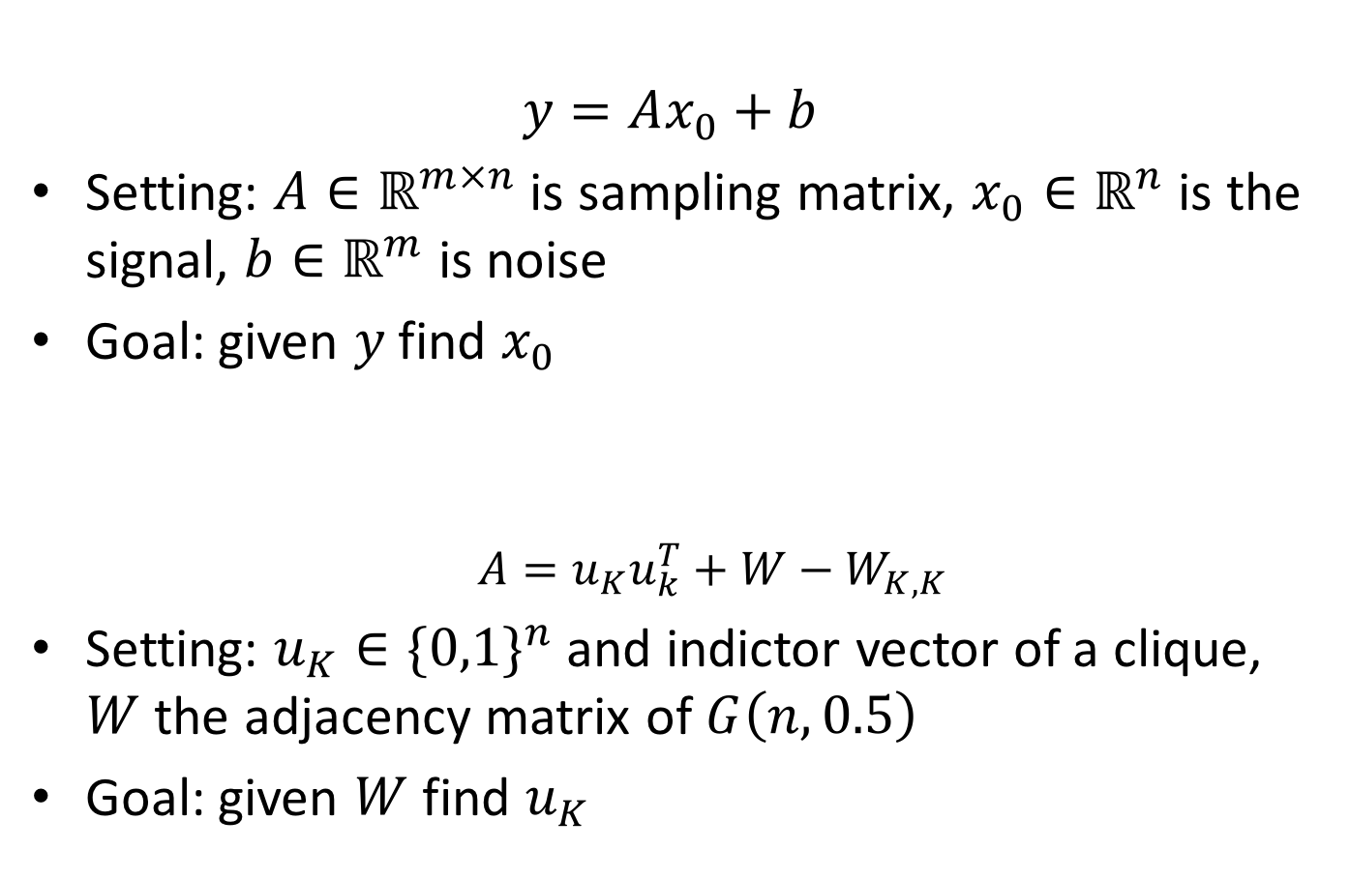
The Denoising Problem
Compressive sensing
$$y=Ax_{0}+b$$
Setting: $A∈ℝ^{m×n}$ is sampling matrix, $x_{0}∈ℝ^{n}$ is the signal, $b∈ℝ^{m}$ is noise
Goal: given $y$find $x_{0}$
$A=u_{K}u_{k}^{T}+W−W_{K,K}$
Setting: $u_{K}∈{\{0,1\}}^{n}$ and indictor vector of a clique, $W$ the adjacency matrix of $G\left(n,0.5\right)$
Goal: given $W$find $u_{K}$
Planted clique

Slide 5
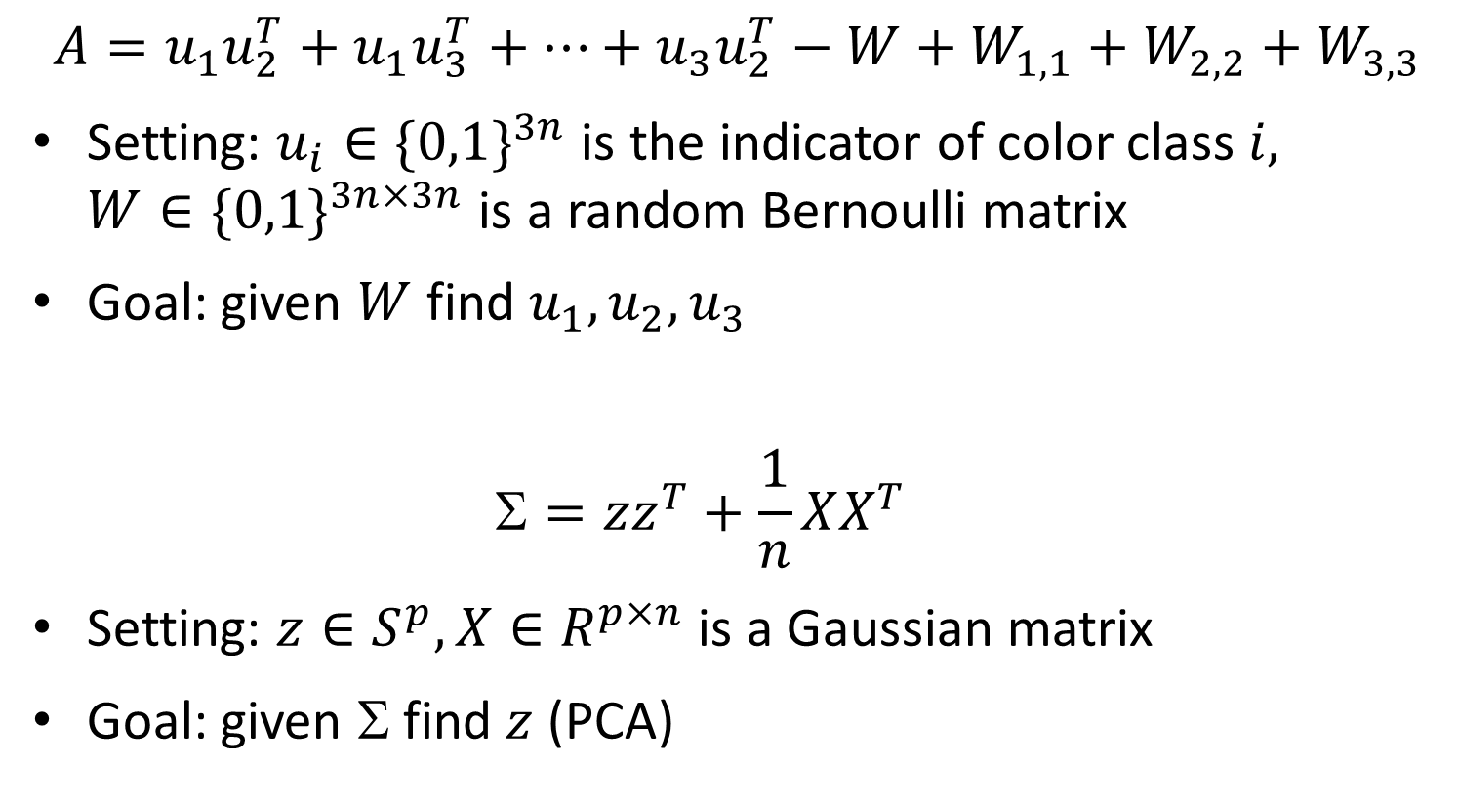
The Denoising Problem contd.
Planted 3-coloring
$$A=u_{1}u_{2}^{T}+u_{1}u_{3}^{T}+…+u_{3}u_{2}^{T}−W+W_{1,1}+W_{2,2}+W_{3,3}$$
Setting: $u_{i}∈{\{0,1\}}^{3n}$ is the indicator of color class $i,$ $W∈{\{0,1\}}^{3n×3n}$ is a random Bernoulli matrix
Goal: given $W$find $u_{1},u_{2},u_{3}$
$$=zz^{T}+\frac{1}{n}XX^{T}$$
Setting: $z∈S^{p}, X∈R^{p×n}$ is a Gaussian matrix
Goal: given $$find $z$ (PCA)
Single-Spike PCA

Slide 6
The Denoising Problem contd.
Same template repeats: Low rank matrix + noise
Low rank matrix is the planted solution
The goal is to recover it
Additional assumptions: sparsity

Slide 7
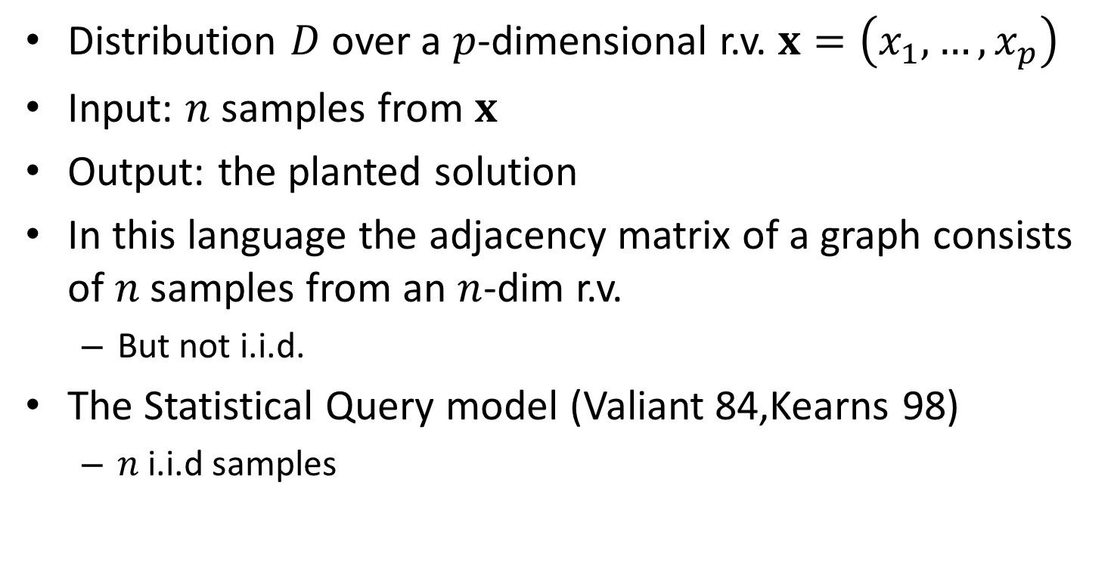
The Statistical Model
Distribution $D$over a $p$-dimensional r.v. $x=\left(x_{1},…,x_{p}\right)$
Input: $n$ samples from $x$
Output: the planted solution
In this language the adjacency matrix of a graph consists of $n$samples from an $n$-dim r.v.
But not i.i.d.
The Statistical Query model (Valiant 84,Kearns 98)
$n$i.i.d samples

Slide 8
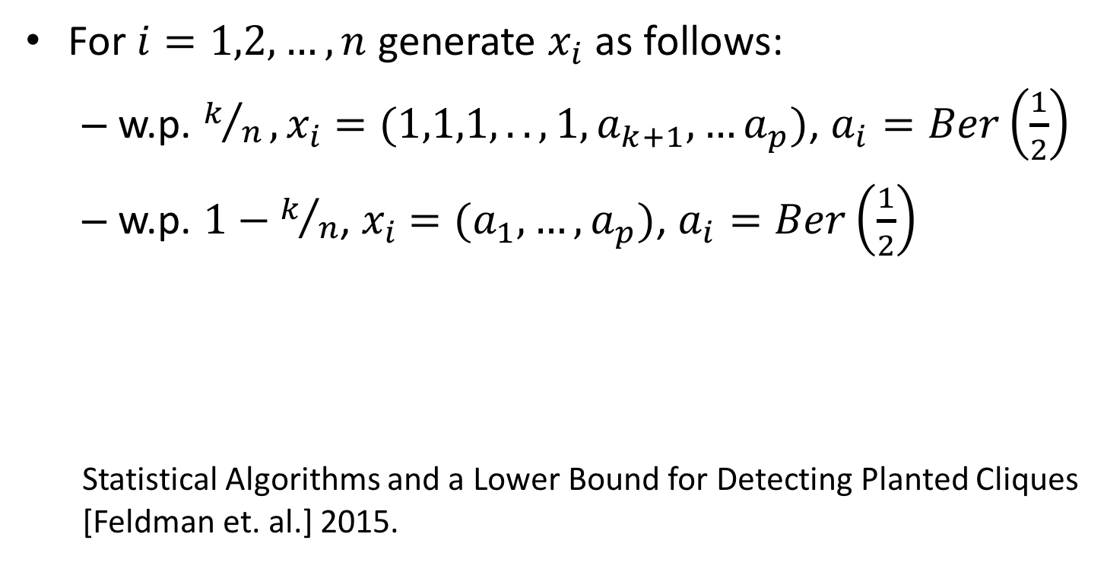
The Planted Clique
For $i=1,2,…,n$ generate $x_{i}$ as follows:
w.p. $k/n, x_{i}$ $=(1,1,1,..,1,a_{k+1},…a_{p})$, $a_{i}=Ber\left(\frac{1}{2}\right)$
w.p. $1−k/n$, $x_{i}$ $=(a_{1},…,a_{p})$, $a_{i}=Ber\left(\frac{1}{2}\right)$
Statistical Algorithms and a Lower Bound for Detecting Planted Cliques [Feldman et. al.] 2015.

Slide 9

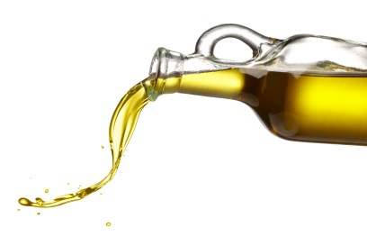
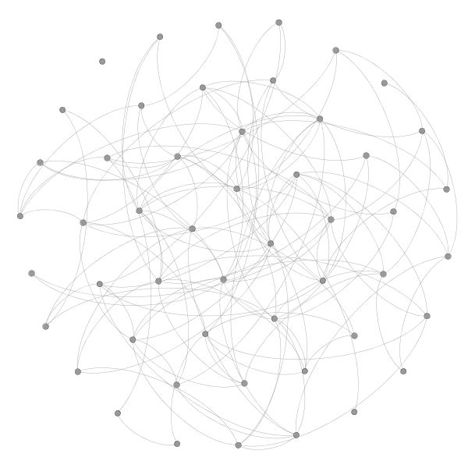


Planted Clique and Sparse PCA
The Planted Clique in $G(n,1/2)$
$$k$$
$$A=u_{K}u_{k}^{T}+W−W_{K,K}$$

Slide 10
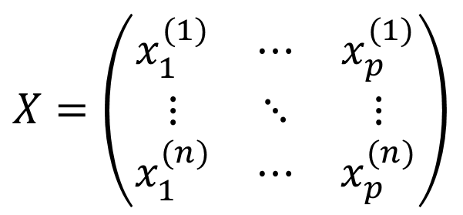
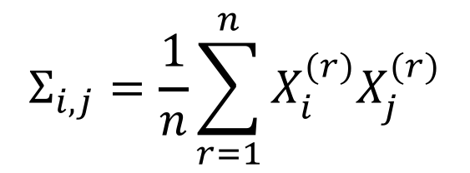
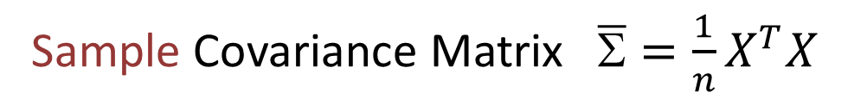

Principal Component Analysis
Population Covariance matrix $=E\left[xx^{T}\right]$
$$_{i,j}=E\left[x_{i}x_{j}\right]$$
Sample Covariance Matrix$\overline{Σ}=\frac{1}{n}X^{T}X$
$$X=\left(\begin{matrix}x_{1}^{(1)} & ⋯ & x_{p}^{(1)} \\ ⋮ & ⋱ & ⋮ \\ x_{1}^{(n)} & ⋯ & x_{p}^{(n)}\end{matrix}\right)$$
$$Σ_{i,j}=\frac{1}{n}\sum_{r=1}^{n}{X_{i}^{(r)}X_{j}^{(r)}}$$
$E\left[\overline{Σ}\right]=Σ$ hence it is an unbiased estimator of $$

Slide 11
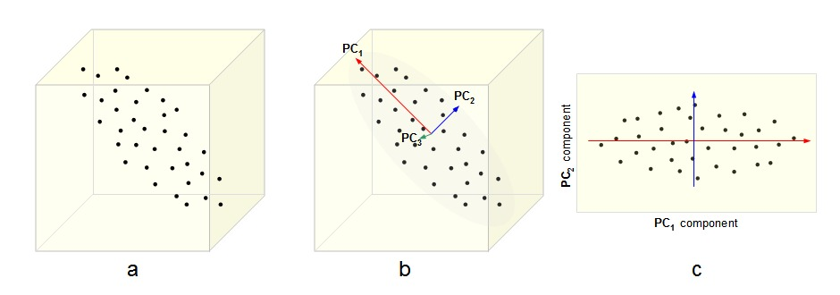


Principal Component Analysis
The variance of $x$ in direction $v$ is $E\left[{\left(xv^{T}\right)}^{2}\right]=$
$=v^{T}E\left[xx^{T}\right]v=v^{T}Σv$
$${⇒ PC}_{1}=arg\max_{v}{v^{T}Σv}$$

Slide 12
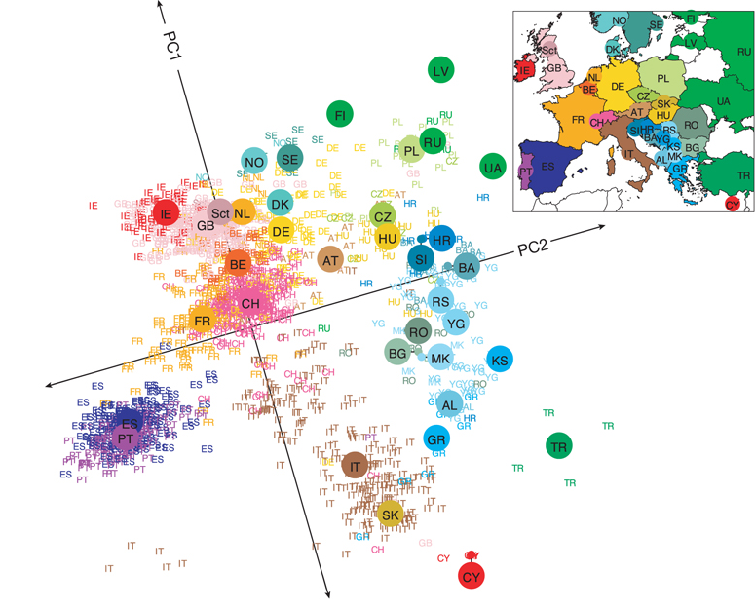
PCA across Science
Genes mirror geography within Europe
Novembre et. al. , Nature 2008

Slide 13
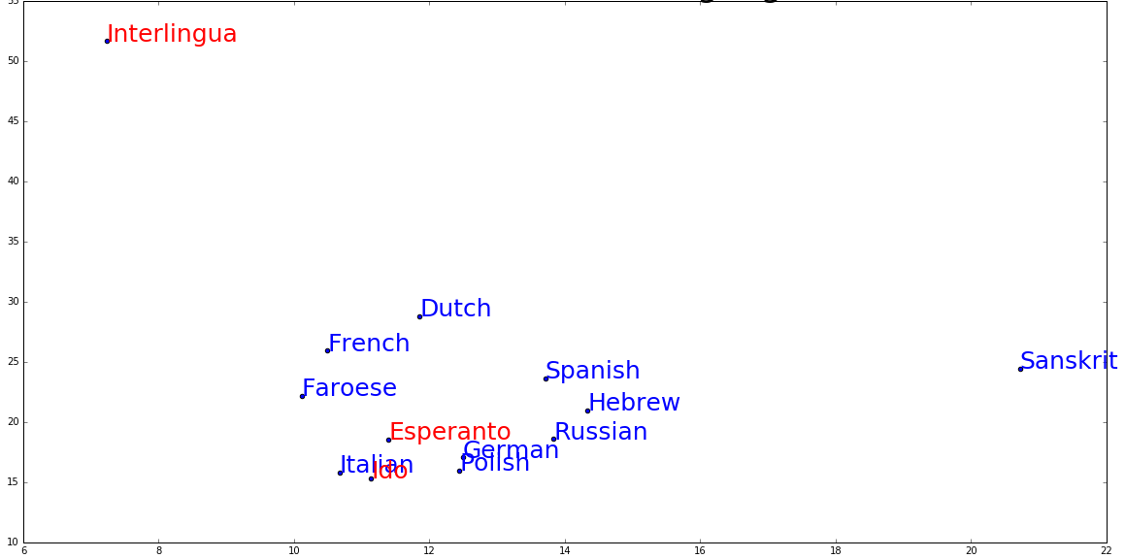
Language Comparison
We trained Googl’es word2vec (Tomas Mikolov) algorithm on various natural and constructed languages
Figure shows PCA results on various languages

Slide 14


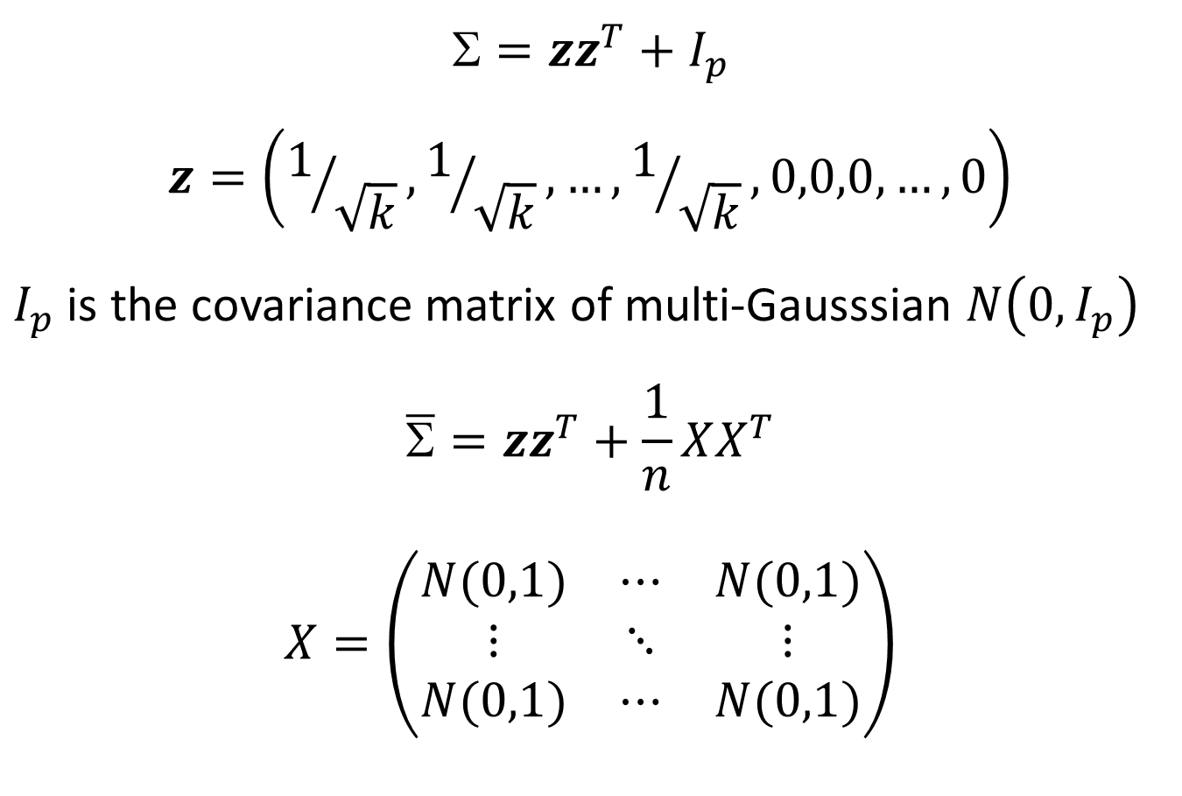
Single Spike Model I. Johnstone (Annals of Stat. 2001)
$$=zz^{T}+I_{p}$$
$$z=\left(1/{\sqrt{k}},1/{\sqrt{k}},…,1/{\sqrt{k}},0,0,0,…,0\right)$$
$I_{p}$ is the covariance matrix of multi-Gausssian $N\left(0,I_{p}\right)$
$$\overline{Σ}=zz^{T}+\frac{1}{n}XX^{T}$$
$$X=\left(\begin{matrix}N(0,1) & ⋯ & N(0,1) \\ ⋮ & ⋱ & ⋮ \\ N(0,1) & ⋯ & N(0,1)\end{matrix}\right)$$
$$p$$
$$n$$

Slide 15


Covariance vs. Adjacency
$$A=u_{K}u_{k}^{T}+W−W_{K,K}$$
$$E[A]=u_{K}u_{k}^{T}$$
But entries of $A$are independent
entries of$$are not!

Slide 16




What would a statistician ask?
Statistical Consistency
${PC}_{1}=\underset{v∈S^{p}}{argmax}{v^{T}Σv}$
${\overline{PC}}_{1}=\underset{}{argmax}{v^{T}\overline{Σ}v}$
$${\overline{PC}}_{1}→{PC}_{1}?$$
True in the classical setting $p/n→0$ but typically not true when $p/n→c$
“the curse of dimensionality” (David Donoho)
ANDERSON, T. W. (1984). An Introduction to Multivariate Statistical Analysis
MUIRHEAD, R. J. (1982). Aspects of Multivariate Statistical Theory

Slide 17
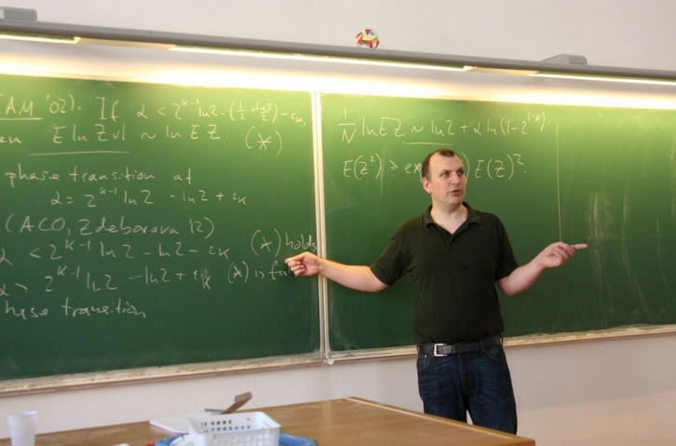
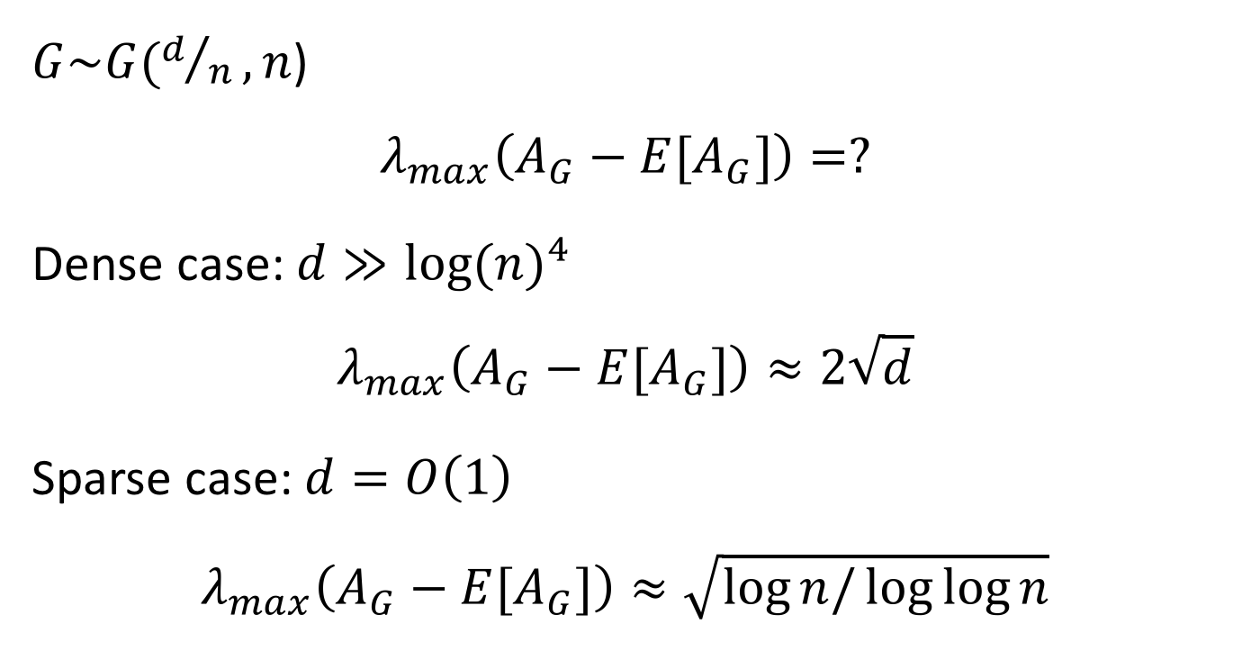
Also in Erdos-Renyi Graphs …
$G\sim G(d/n,n$)
$$λ_{max}\left(A_{G}−E[A_{G}]\right)=?$$
Dense case: $d≫{log⁡(n)}^{4}$
$$λ_{max}\left(A_{G}−E[A_{G}]\right)≈2\sqrt{d}$$
Sparse case: $d=O\left(1\right)$
$$λ_{max}\left(A_{G}−E[A_{G}]\right)≈\sqrt{\log{n/\log{\log{n}}}}$$
KS03; Vu05

Slide 18
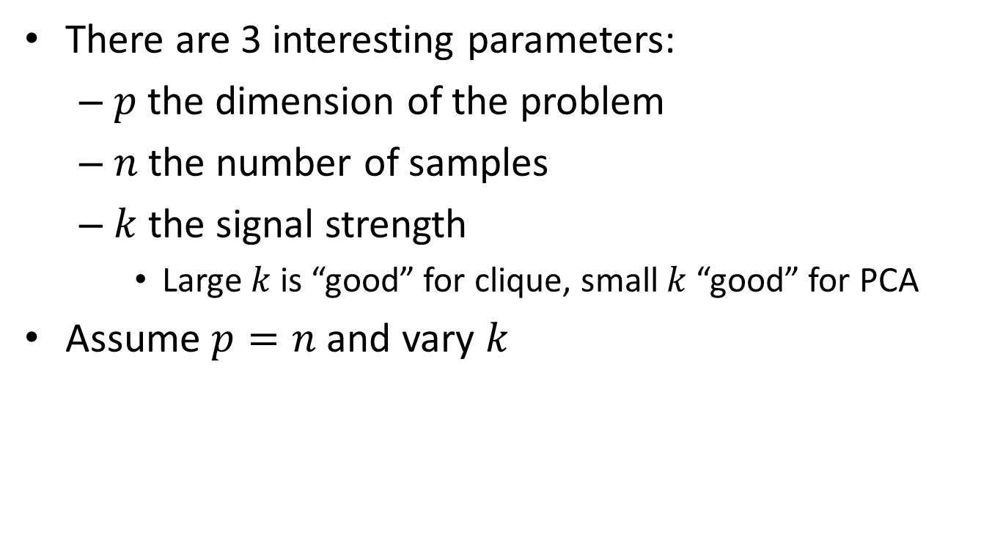






Half way through … no phase transision?! ☹
There are 3 interesting parameters:
$p$the dimension of the problem
$n$the number of samples
$k$the signal strength
Large $k$ is “good” for clique, small $k$ “good” for PCA
Assume $p=n$ and vary $k$
$$2log{n}$$
$$n^{0.5}$$
$$k$$
Information
Threshold
Computational
Threshold
Information
Threshold
$$k$$
$$n^{0.5}$$
$$n/\log{n}$$

Slide 19




Zoom in on computational threshold
Do we have an algorithmic complexity threshold?
For $k≤k_{0}$ simple greedy algorithms work
For $k≫k_{0}$ one needs fancy methods (SDP, Spectral, BP)
$$k≈\sqrt{n}$$
$$k≈\sqrt{n\log{n}}$$
Spectral algorithm (AKS98)
SDP (FK00)
Counting degrees works
$$k$$

Slide 20
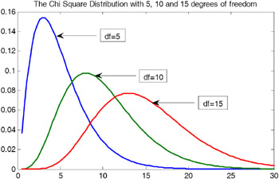


Algorithmic approaches
Obsv. 1.: If $x\sim N\left(0,I_{n}\right)$ then ${\left\|x\right\|}^{2}\sim χ_{n}^{2}$
$${\left\|x\right\|}^{2}=x_{1}^{2}+x_{2}^{2}+…x_{n}^{2}$$

Slide 21





One more fact …
Obsv.2 : The product of two $n$-dimensional Gaussian vectors is distributed $\sqrt{a∙}b$ where $b\sim N\left(0,1\right)$ and $a\sim χ_{n}^{2}$, $a$ and $b$ are indep.
$$e_{1}∙\left\|x\right\|$$
$$E\left[\sqrt{a∙}b\right]=0$$
$$SD\left[\sqrt{a∙}b\right]=Θ(\sqrt{n})$$
$$(x_{1},…,x_{n})$$
$$(y_{1},…,y_{n})$$

Slide 22
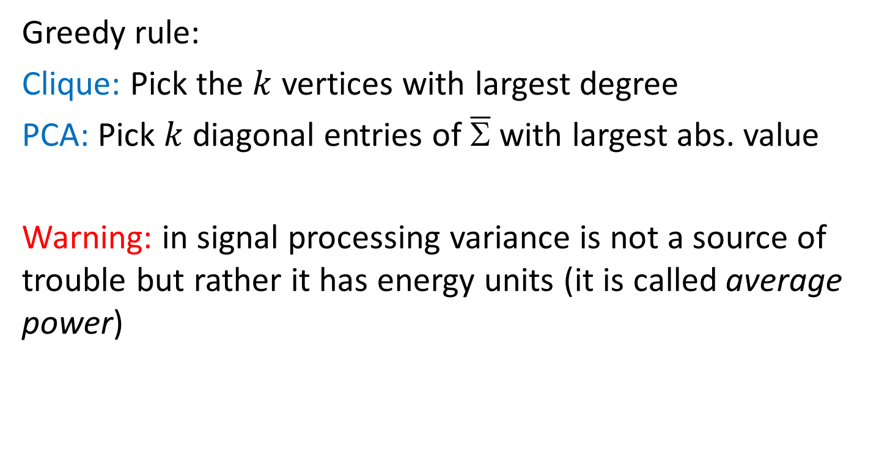
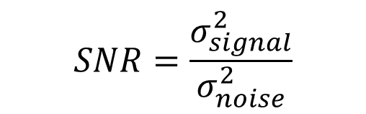
Simple Greedy Rules
Greedy rule:
Clique: Pick the $k$ vertices with largest degree
PCA: Pick $k$diagonal entries of $\overline{Σ}$ with largest abs. value
Warning: in signal processing variance is not a source of trouble but rather it has energy units (it is called average power)
$$SNR=\frac{σ_{signal}^{2}}{σ_{noise}^{2}}$$

Slide 23
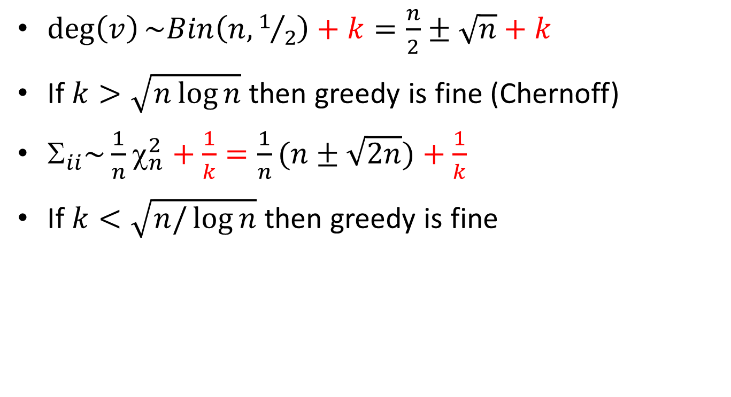
When does greedy work?
$\deg\left(v\right)\sim Bin\left(n,1/2\right)+k=\frac{n}{2}±\sqrt{n}+k$
If $k>\sqrt{n\log{n}}$ then greedy is fine (Chernoff)
$_{ii}\sim \frac{1}{n}χ_{n}^{2}+\frac{1}{k}=\frac{1}{n}(n±\sqrt{2n})+\frac{1}{k}$
If $k<\sqrt{n/\log{n}}$ then greedy is fine

Slide 24


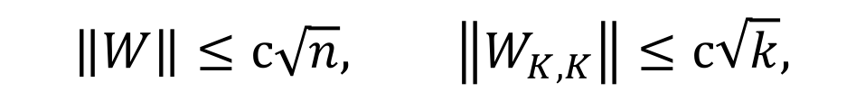
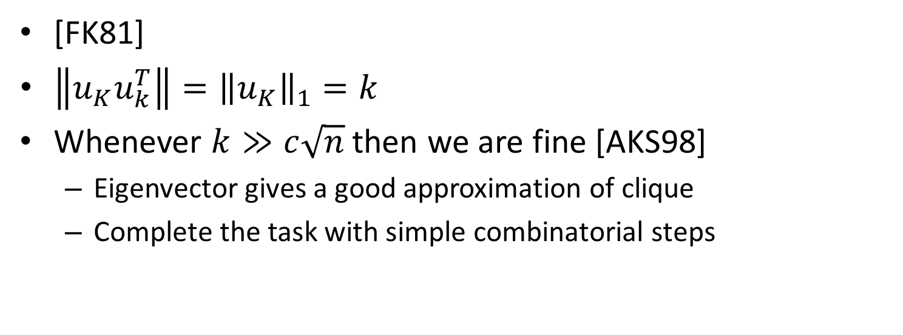
Spectral Approaches
$$A=u_{K}u_{k}^{T}+W−W_{K,K}$$
$$W_{ij}∈\{1,−1\}$$
$$\left\|W\right\|≤c\sqrt{n}, \left\|W_{K,K}\right\|≤c\sqrt{k},$$
[FK81]
$\left\|u_{K}u_{k}^{T}\right\|={\left\|u_{K}\right\|}_{1}=k$
Whenever $k≫c\sqrt{n}$ then we are fine [AKS98]
Eigenvector gives a good approximation of clique
Complete the task with simple combinatorial steps

Slide 25
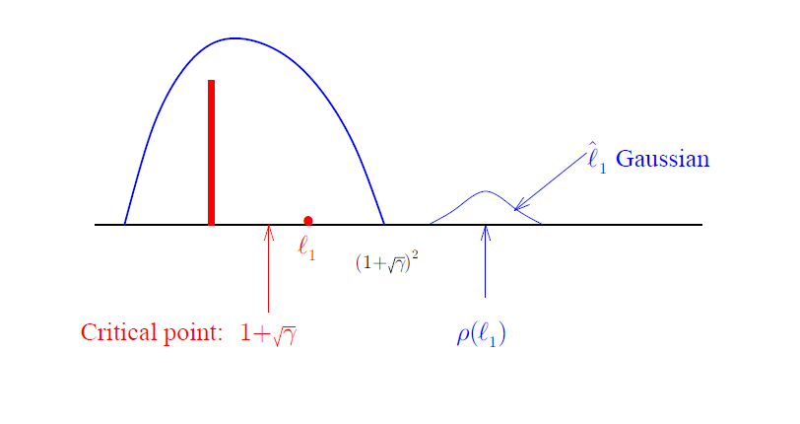
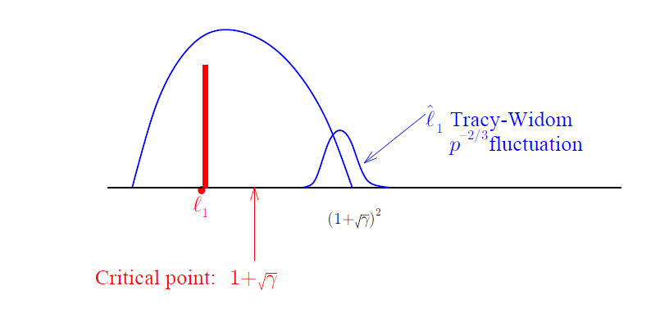
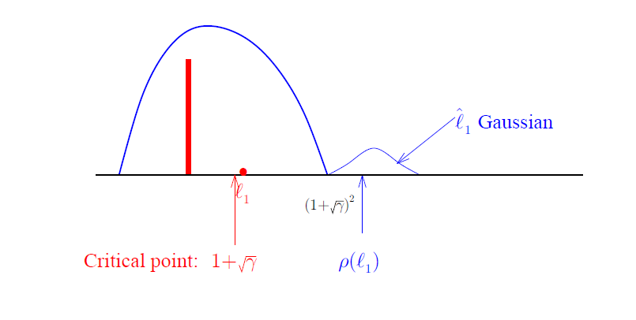
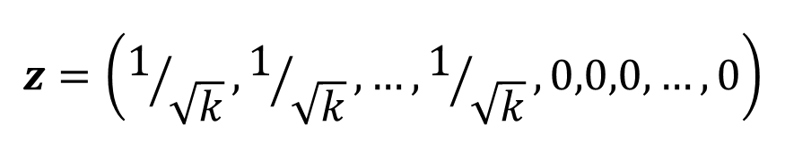
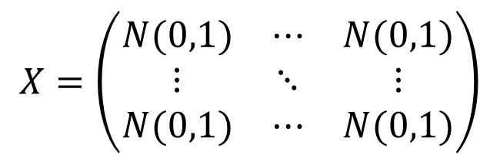
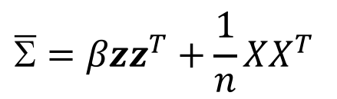
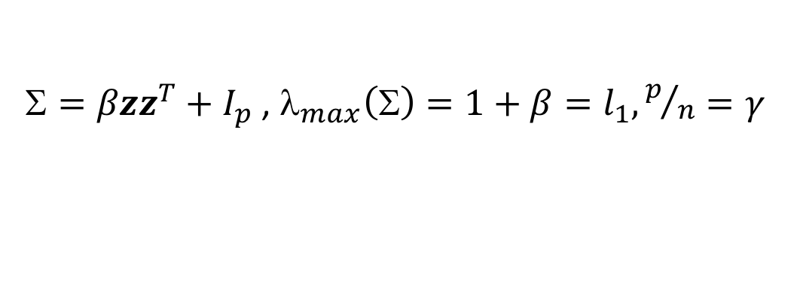
How about PCA?
$=βzz^{T}+I_{p}$ , $_{max}\left(Σ\right)=1+β=l_{1}, p/n=γ$
$$\overline{Σ}=βzz^{T}+\frac{1}{n}XX^{T}$$
$$z=\left(1/{\sqrt{k}},1/{\sqrt{k}},…,1/{\sqrt{k}},0,0,0,…,0\right)$$
$$X=\left(\begin{matrix}N(0,1) & ⋯ & N(0,1) \\ ⋮ & ⋱ & ⋮ \\ N(0,1) & ⋯ & N(0,1)\end{matrix}\right)$$
Baik-Silverstein, Paul, El-Karoui, Ma (~10 years ago)

Slide 26
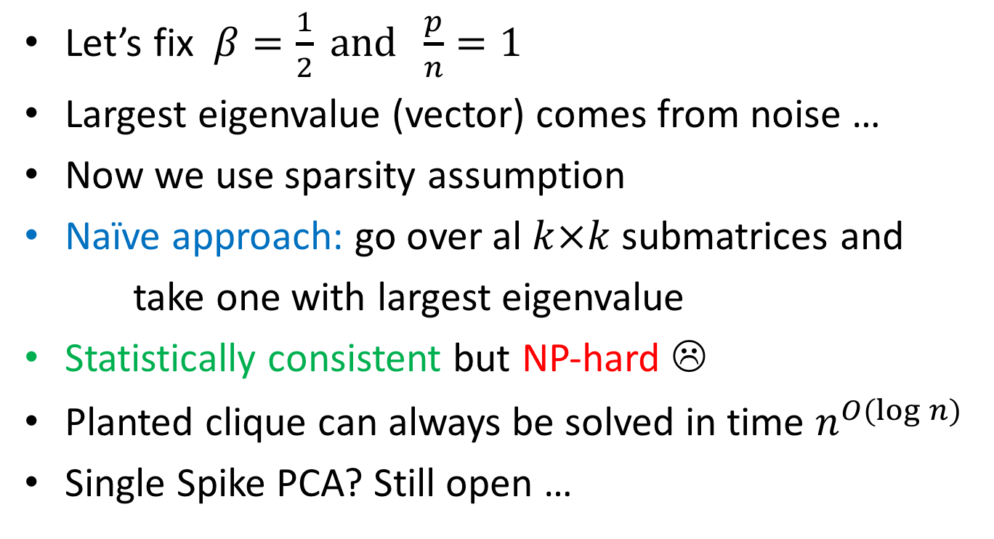
PCA contd.
Let’s fix $β=\frac{1}{2} and \frac{p}{n}=1$
Largest eigenvalue (vector) comes from noise …
Now we use sparsity assumption
Naïve approach: go over al $k×k$ submatrices and
take one with largest eigenvalue
Statistically consistent but NP-hard ☹
Planted clique can always be solved in time $n^{O(log{n)}}$
Single Spike PCA? Still open …

Slide 27

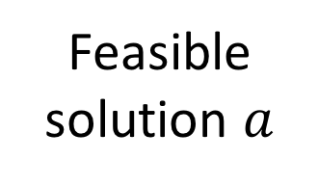
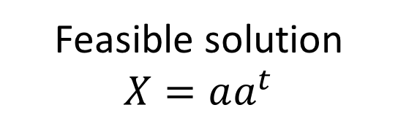
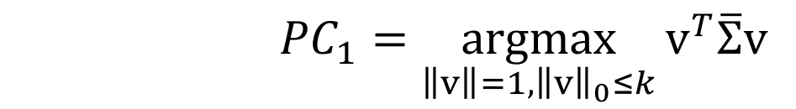
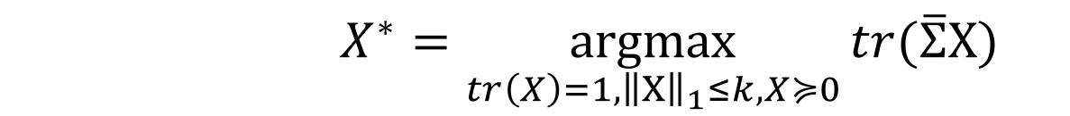
Semi-definite Programming Approach
Feasible solution $a$
${PC}_{1}=\underset{\left\|v\right\|=1,{\left\|v\right\|}_{0}≤k}{argmax}{v^{T}\overline{Σ}v}$
SDP Relaxation
[d`Aspremont et al. 2004]
Feasible solution
$$X=aa^{t}$$
$X^{∗}=\underset{tr\left(X\right)=1,{\left\|X\right\|}_{1}≤k,X≽0}{argmax}{tr(\overline{Σ}X)}$
How to round a solution? Take leading eigenvector of $X$

Slide 28
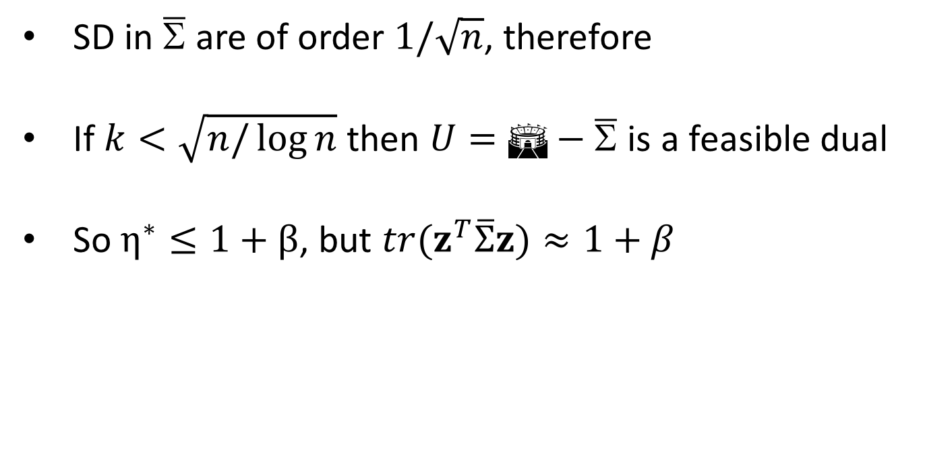
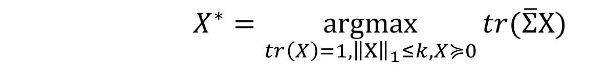
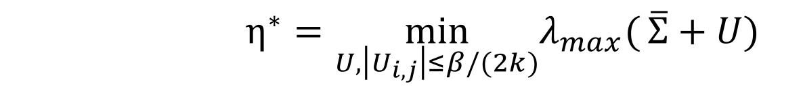
SDP Dual
$X^{∗}=\underset{tr\left(X\right)=1,{\left\|X\right\|}_{1}≤k,X≽0}{argmax}{tr(\overline{Σ}X)}$
$η^{∗}=\min_{U,\left|U_{i,j}\right|≤β/(2k)}λ_{max}({\overline{Σ}+U)}$
SD in $\overline{Σ}$ are of order $1/\sqrt{n}$, therefore
If $k<\sqrt{n/\log{n}}$ then $U=Σ−\overline{Σ}$ is a feasible dual
So $η^{∗}≤1+β$, but ${tr(z^{T}\overline{Σ}z)≈1+β}^{}$

Slide 29
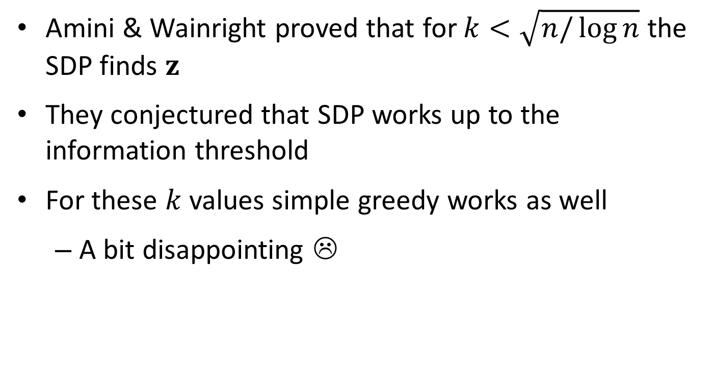
SDP Duality contd.
Amini & Wainright proved that for $k<\sqrt{n/\log{n}}$ the SDP finds $z$
They conjectured that SDP works up to the information threshold
For these $k$ values simple greedy works as well
A bit disappointing ☹

Slide 30
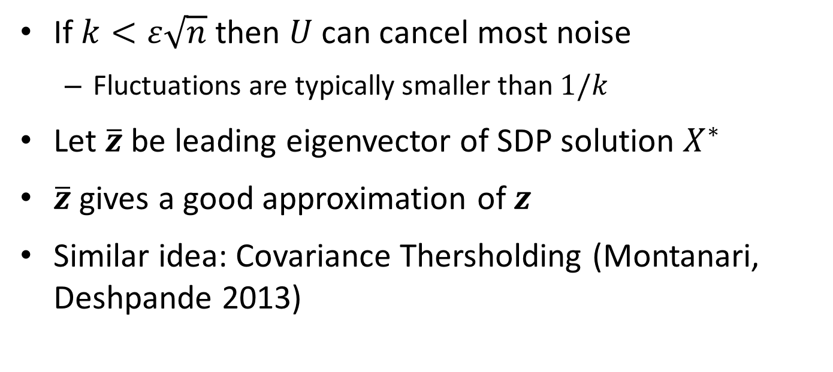
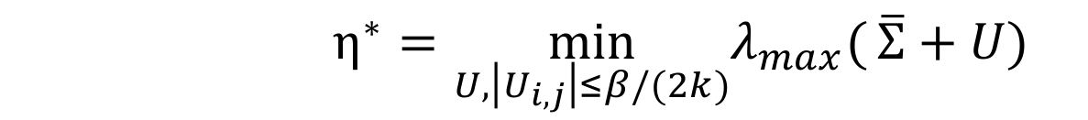

Does SDP work for larger $k$?
$η^{∗}=\min_{U,\left|U_{i,j}\right|≤β/(2k)}λ_{max}({\overline{Σ}+U)}$
If $k<ε\sqrt{n}$ then $U$ can cancel most noise
Fluctuations are typically smaller than $1/k$
Let $\overline{z}$ be leading eigenvector of SDP solution $X^{∗}$
$\overline{z}$ gives a good approximation of $z$
Similar idea: Covariance Thersholding (Montanari, Deshpande 2013)

Slide 31
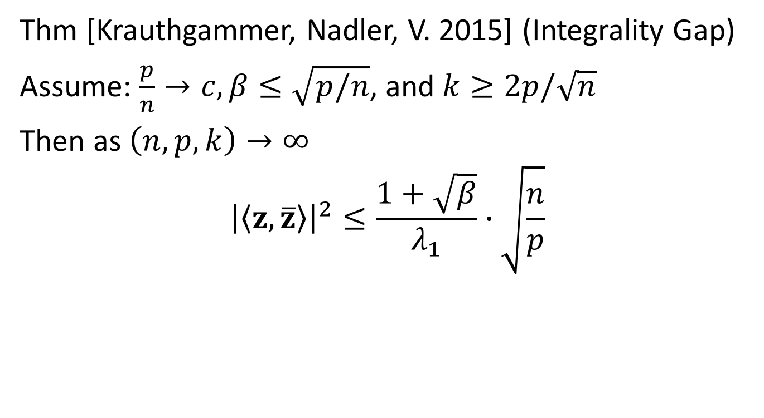
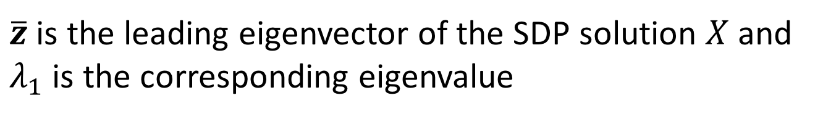

Does SDP work for larger $k$?
Thm [Krauthgammer, Nadler, V. 2015] (Integrality Gap)
Assume: $\frac{p}{n}→c, β≤\sqrt{p/n}$, and $k≥2p/\sqrt{n}$
Then as $\left(n,p,k\right)→∞$
$${\left|\left\langle z,\overline{z}\right\rangle \right|}^{2}≤\frac{1+\sqrt{β}}{λ_{1}}∙\sqrt{\frac{n}{p}}$$
$\overline{z}$ is the leading eigenvector of the SDP solution $X$ and $λ_{1}$ is the corresponding eigenvalue
Feige-Krauthgammer proved similar result in 2000 for Clqiue

Slide 32
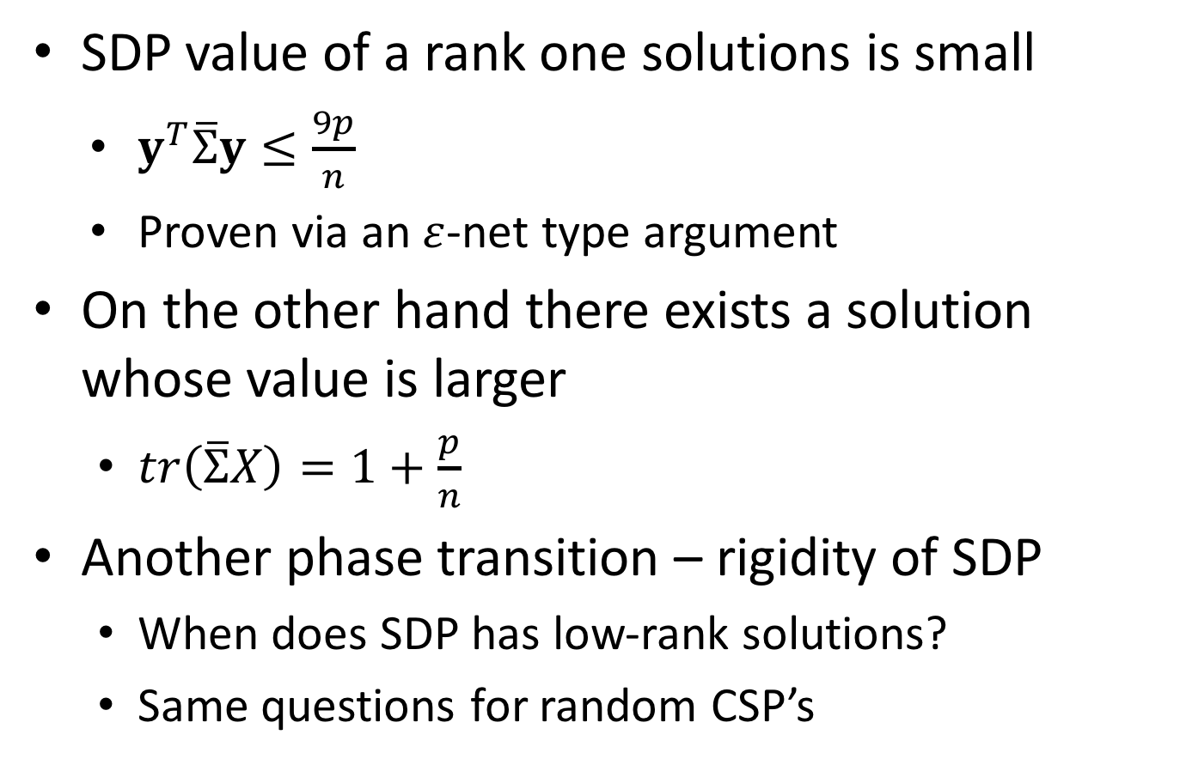
Proof Ideas
SDP value of a rank one solutions is small
$y^{T}\overline{Σ}y≤\frac{9p}{n}$
Proven via an $ε$-net type argument
On the other hand there exists a solution whose value is larger
$tr\left(\overline{Σ}X\right)=1+\frac{p}{n}$
Another phase transition – rigidity of SDP
When does SDP has low-rank solutions?
Same questions for random CSP’s

Slide 33
Greedy approach revisited
So what have we seen so far?
When signal is stronger than standard deviations – simple greedy works
When signal is on par with standard deviations – spectral/SDP works
When signal is smaller than standard deviations – still can be solved, but maybe not efficiently …
Is this really so? …

Slide 34

Not entirely so…
Reverse greedy approach
Order vertices in decreasing order of likelihood of being part of the solution
Remove most unlikely vertex
Repeat
Planted clique: Feige Ron 2010
Remove vertex with least degree, repeat.
For $k≈\sqrt{n}$ this algorithm finds a clique whp

Slide 35

Reverse Greedy on Cov. Matrix
Consider the following algorithm
Each time remove a row of $\overline{Σ}$ with lowest $l_{2}$ norm
Remove its corresponding column
Repeat
Executions show that this algorithm works the same as SDP
Proof?

Slide 36


Time-data tradeoffs
Risk of a binary classifier $g$is ${Pr}_{X} [g(X) ≠ Y]$
Game 1: train $g$on a set of points such that as you
get more data the risk reduces
Game 2: train $g$on a set of points such that as you
get more data it takes less time to train $g$
Algorithmic weakening vs SDP hierarchies
Computational and Statistical Tradeoffs via Convex Relaxation
Chandrasekaran and Jordan, PNAS 2013

Slide 37
Conclusion
High-dimensional statistics is a very hot topic
Big-data, genetics, algo-trading
The nature of the problems requires interdisciplinary solutions
Our training (theoretical CS) is very handy
Knowledge of algorithms, optimization, probability
The problems have very similar flavor to what we are used to

Slide 38

Thank you

Slide 39

Postdoc

